Slide 1
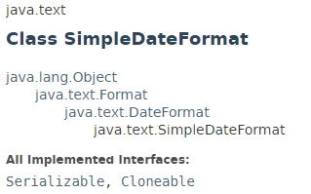
SimpleDateFormat
SimpleDateFormat is a concrete class for formatting and parsing dates in a locale-sensitive manner. It allows for formatting
(date → text), parsing (text → date), and normalization.
SimpleDateFormat allows you to start by choosing any user-defined patterns for date-time formatting. However, you are encouraged to create a date-time formatter with either getTimeInstance, getDateInstance, or getDateTimeInstance in DateFormat. Each of these class methods can return a date/time formatter initialized with a default format pattern. You may modify the format pattern using the applyPattern methods as desired. For more information on using these methods

Slide 2
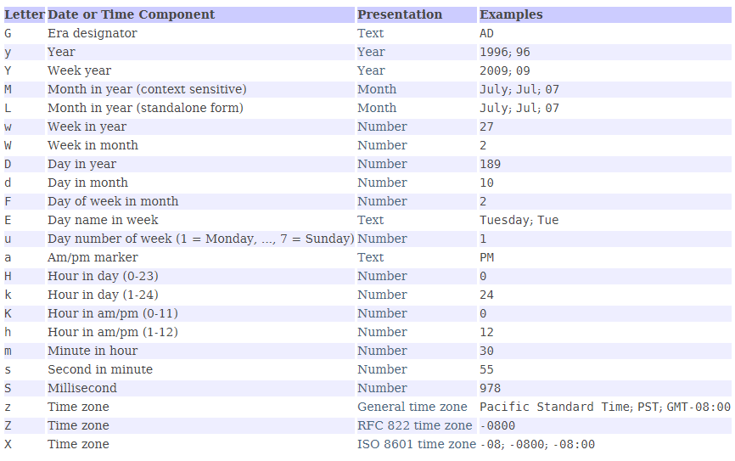
SimpleDateFormat

Slide 3
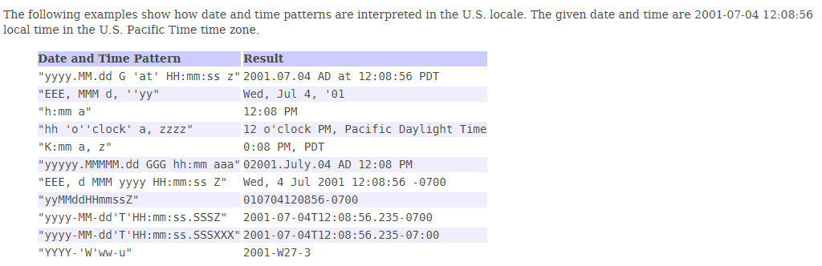
SimpleDateFormat

Slide 4
DateFormat
https://docs.oracle.com/javase/8/docs/api/index.html?java/text/SimpleDateFormat.html

